Slide 1

COMP 5350 / 6350 / 6356 Digital Forensics Spring 2019

Slide 2
Project #1 Questions

Slide 3
DES - FAT Example
File Allocation Table
512 bytes / sector
4 sectors / cluster
2048 bytes / cluster
Cluster | Next Cluster
0 | 1
1 | 2
Directory Entry Structure
1000 | 1001
1002 | 1003
1003 | 1004
1004 | FFFF
1005 | 1006
1006 | 1007
1007 | 1008
1008 | 1009
1009 | FFFF
1010 | 1011
1011 | 1012
Filename | Cluster | File Size
Budget.txt | 1000 | 7980 bytes
Resume.docx | 1005 | 10120 bytes
Algorithm.py | 1010 | 60295 bytes
The directory entry structure specifies the starting cluster and the file size
The FAT points to follow-on cluster or the end of the file (i.e. 0xFFFF)
1037 | 1037
1038 | 1039
1039 | FFFF

Slide 4
Exam Style Questions

Slide 5
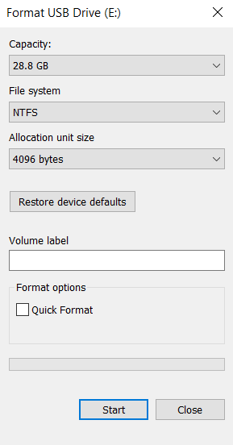
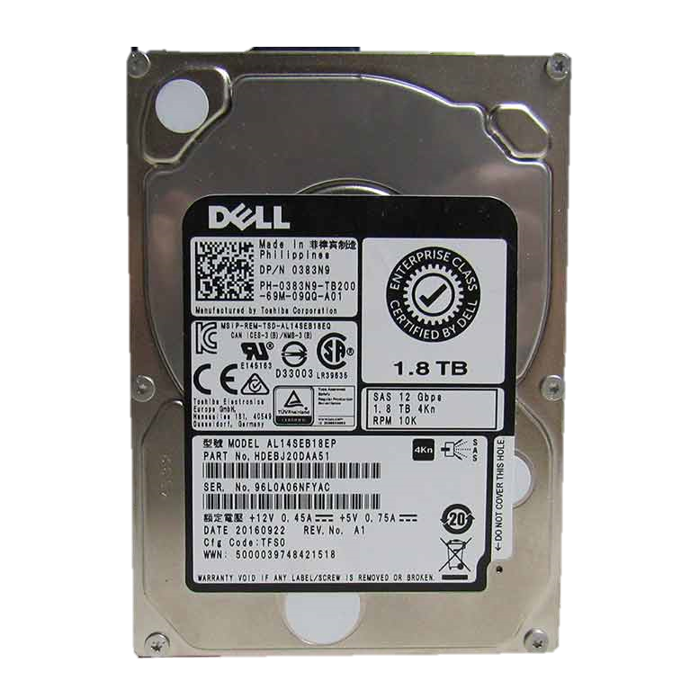

The disk show below was configured with the following settings. How many bytes are in one cluster?
512 bytes
4096 bytes
32,728 bytes
65,536 bytes

Slide 6
The disk show below was configured with the following settings. How many bytes are in one cluster?
512 bytes
4096 bytes
32,728 bytes
65,536 bytes
(4096 bytes / sector)*(8 sectors / cluster)*(512 bytes / sector)
=
32,728 bytes / sector

Slide 7

The SD card shown below must be configured with a maximum file size and partition size of 2 GB. Which of the following file systems needs to be configured on the card?
FAT12
FAT16
FAT32
NTFS

Slide 8
The SD card shown below must be configured with a maximum file size and partition size of 2 GB. Which of the following file systems needs to be configured on the card?
FAT12
FAT16
FAT32
NTFS

Slide 9
Specify the correct name of the 4 NTFS partition areas shown below
a
b
c
d

Slide 10
Specify the correct name of the 4 NTFS partition areas shown below
a
b
c
d
Master
File
Table
Backup
Master
Boot
Record
Master
File
Table
File
Data
Area

Slide 11
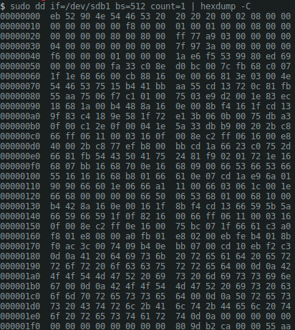
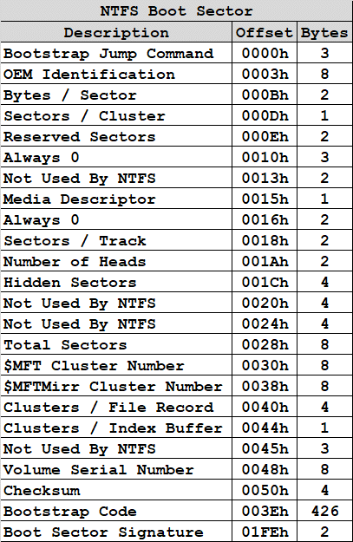
For the NFTS MBR shown below, specify the correct value of the start of the MFT cluster:
0x7F
0x04
0x977F
0x20

Slide 12
For the NFTS MBR shown below, specify the correct value of the start of the MFT cluster:
0x7F
0x04
0x977F
0x20

Slide 13
Windows VM Configuration

Slide 14
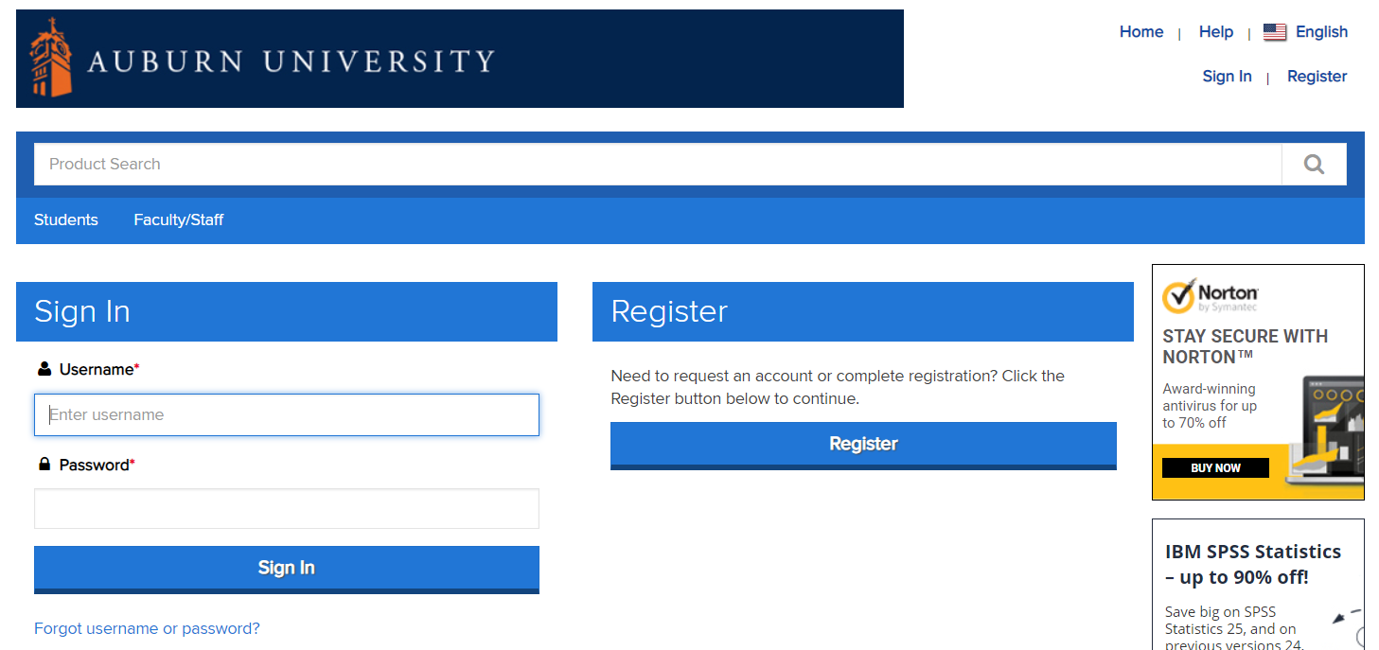
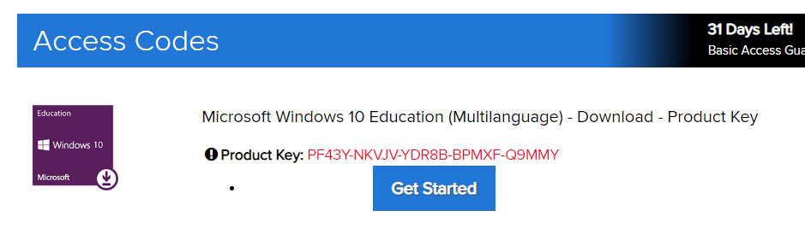
Windows 10 Education
We will utilize the current version of Windows to conduct our forensic analysis of Windows artifacts
Student Windows Version
https://auburn.onthehub.com

Slide 15
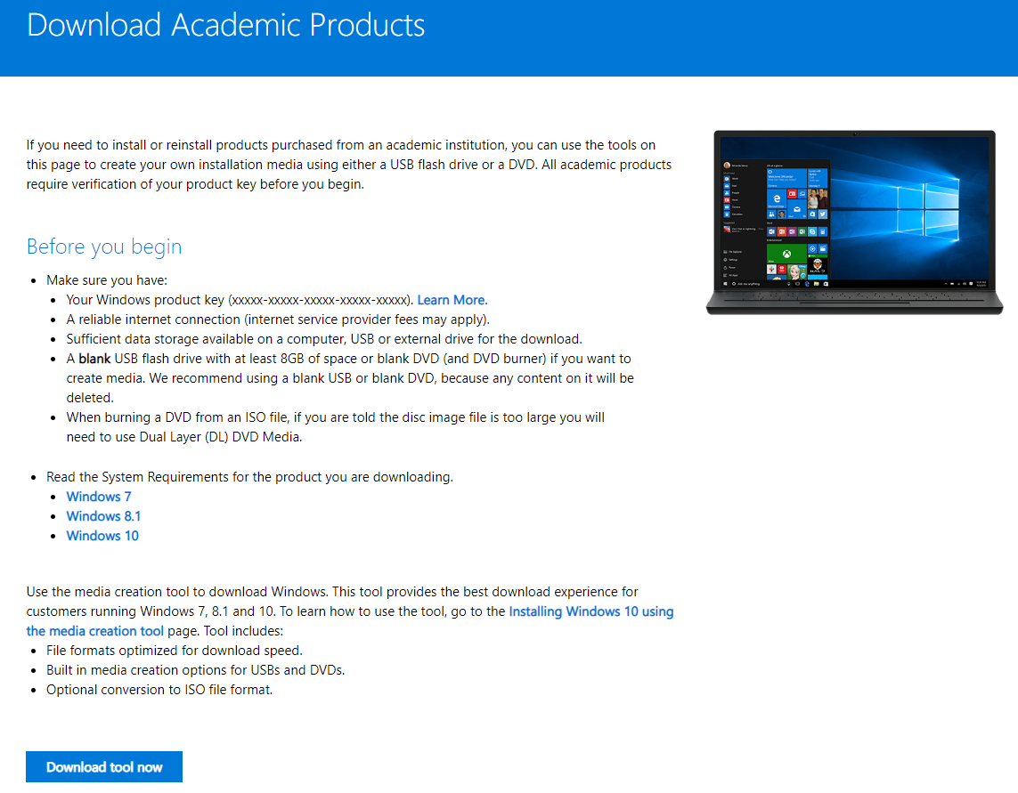
Windows ISO Download

Slide 16
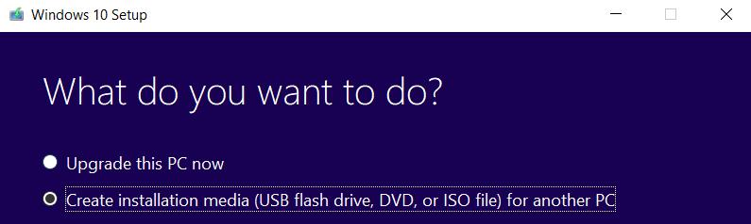
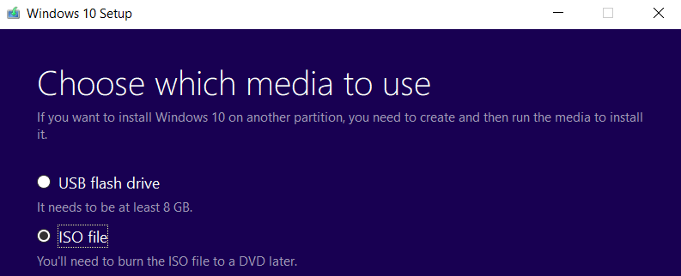
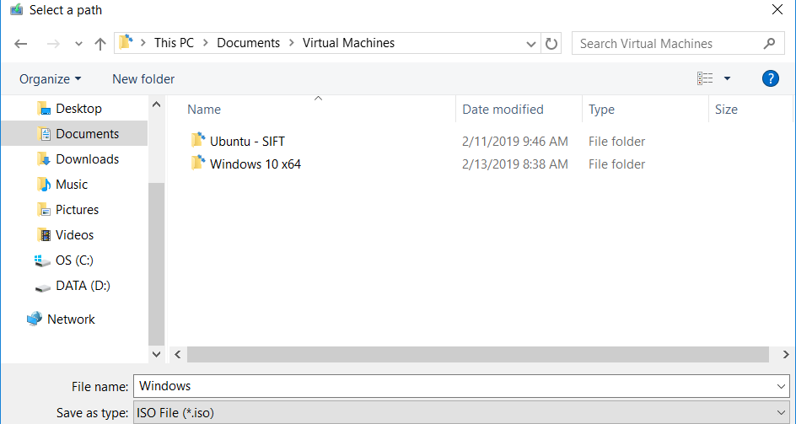
Windows ISO

Slide 17
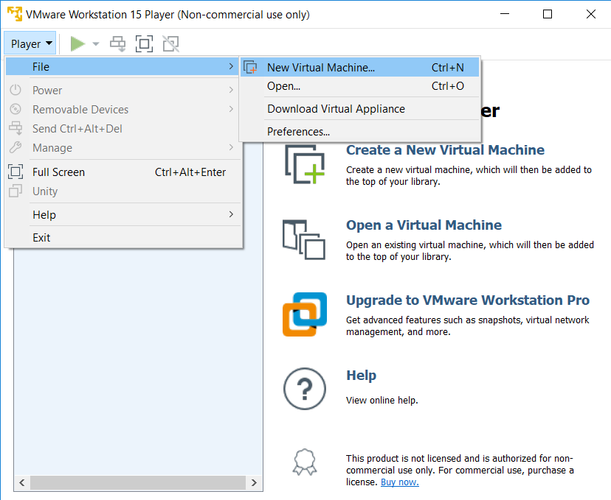
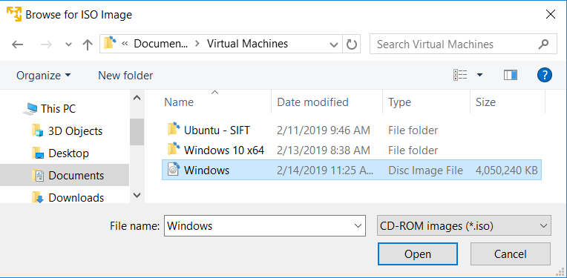
Windows VM Installation

Slide 18
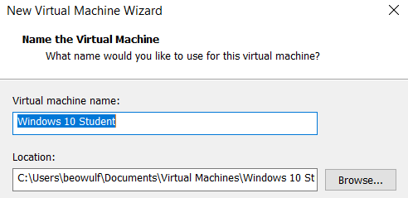
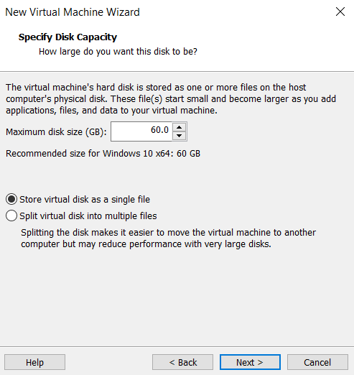
Windows VM Installation Settings

Slide 19
Windows VM Installation (con’t)

Slide 20
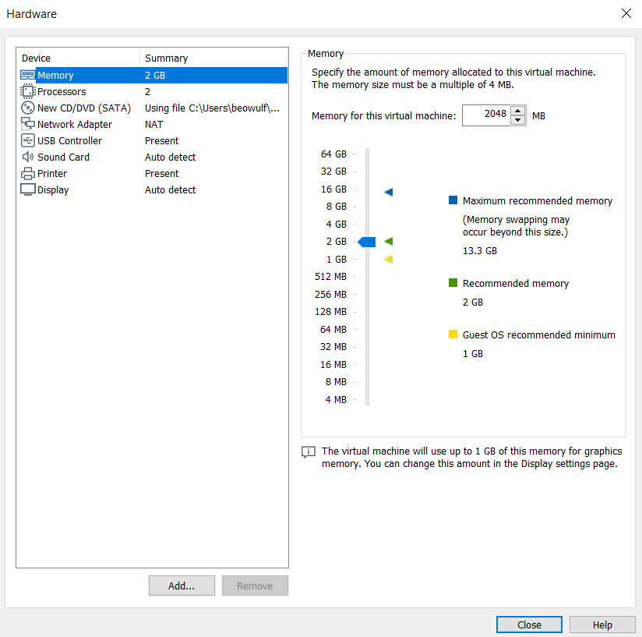
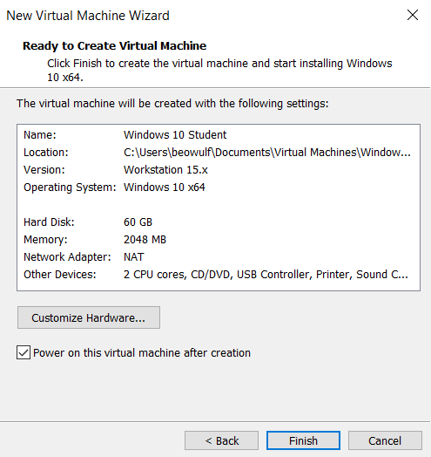
Windows VM Installation (con’t)

Slide 21
Windows Operating System Forensics

Slide 22
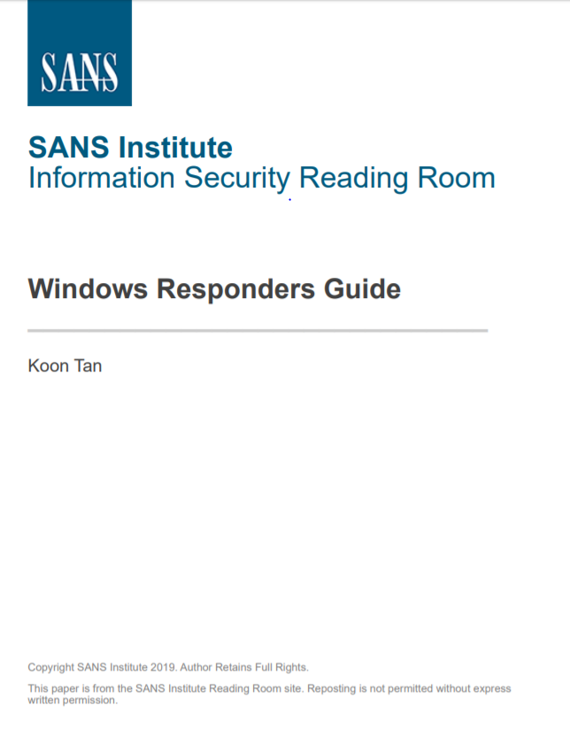
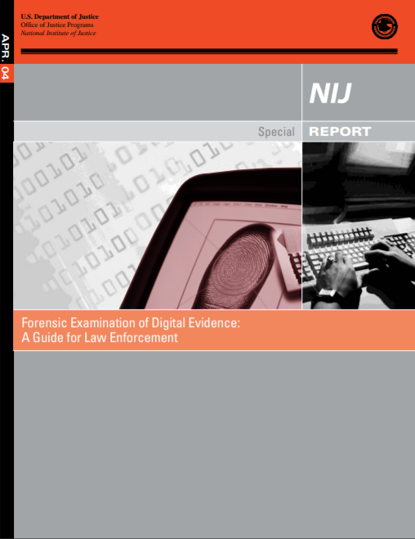
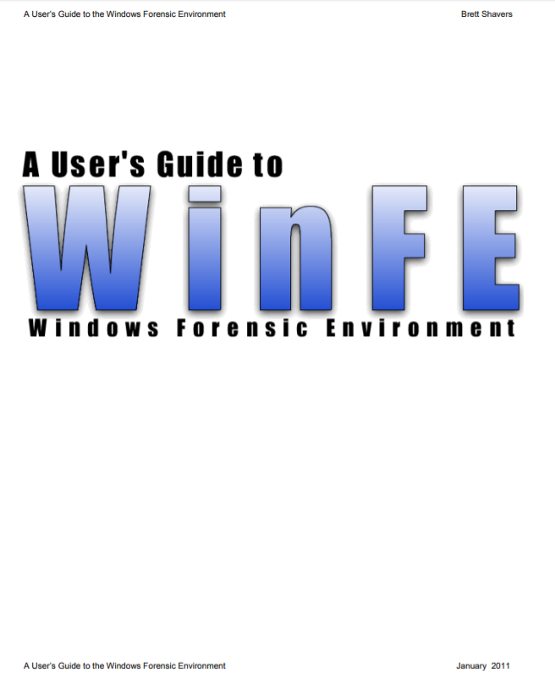
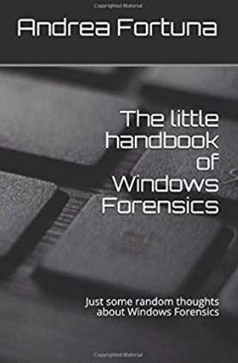
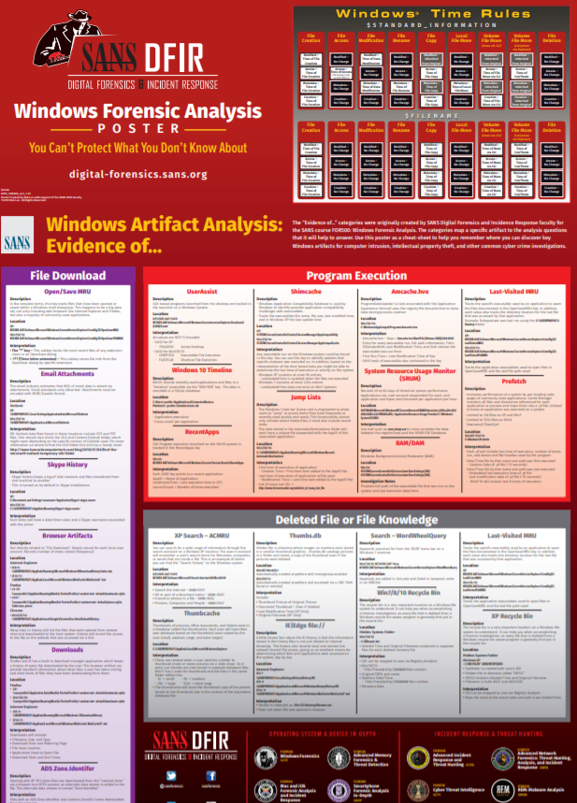
Windows Forensics Best Practices
There are numerous sources for Windows forensics best practices from security experts in numerous fields
Many sources are compiled with security testing in mind:
SANS DFIR
SANS Reading Room
Windows Forensics Best Practices
Forensics Legal Considerations

Slide 23
Windows Forensics Best Practices
Utilizing best practices specified in the Windows Responses Guide, we can classify forensic and response activities into the following steps:
Conduct Initial Response
Evidence Gathering
Protect Volatile Information
Create a Forensics Response Toolkit
Gather Physical & Digital Evidence
Script Data Collection
Identify Footprints
Before a forensic event occurs organizations should have steps fully implemented through:
Response Policy
Subject Matter Expertise
Personnel Training
Forensic Testing Environment
Organizational Exercises

Slide 24
Conduct Initial Response
A forensics analysis will be conducted if it has been determined that negative activity has occurred on the network
Security Breach
Data Exfiltration
Successful Social Engineering
A number of questions need to be asked during this process:
Who found the incident?
How was the incident discovered?
When did the incident occur?
What was the level of damage?
Where was the attack initiated?
What techniques were being used to compromise the system?
Before any technical solutions can be applied the organization must establish the proper scope of the investigation to be conducted and the desired results

Slide 25
Evidence Gathering
The first principle of evidence gathering is to conduct as few activities on the system as possible and maintain detailed evidence documentation to include all steps conducted
Incident response and forensic collection policies should address chain of custody
During the initial evidence gathering process we should not:
Overwrite original media
Kill any processes
Manipulate timestamps
Utilize untrusted collection or analysis tools
Perform any system modifications including:
Reboot
Patching
Updating
Reconfiguring

Slide 26
Protect Volatile Information
Recall in an earlier discussion we spoke of the order of volatility (OOV) of a system
With a Windows forensic analysis, OOV also applies:
CPU Registers & Cache
RAM Contents
Network Connections
Running Processes
Hard Drive File System
Removable and Backup Media
The most critical information contained in volatile memory includes:
System Timestamps
Running and Active Processes
Network Connections
Port Status
Open
Listening
Connected
Time Wait
Current logon users

Slide 27
Create a Forensics Response Toolkit
There are numerous tools available to conduct forensic analysis activities and it is critical to vet all tools being used
Forensic analysis teams should consolidate tools into a single repository and ensure all software dependences are accounted for
To ensure the target system is not negatively affected tools such as filemon can be used to determine if tools will cause modification to the system

Slide 28
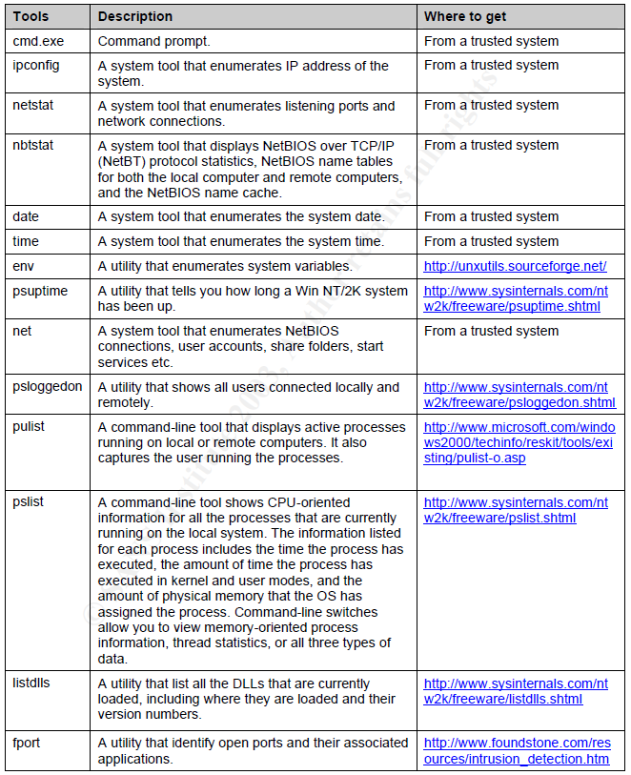
List of Response Toolkit Tools

Slide 29
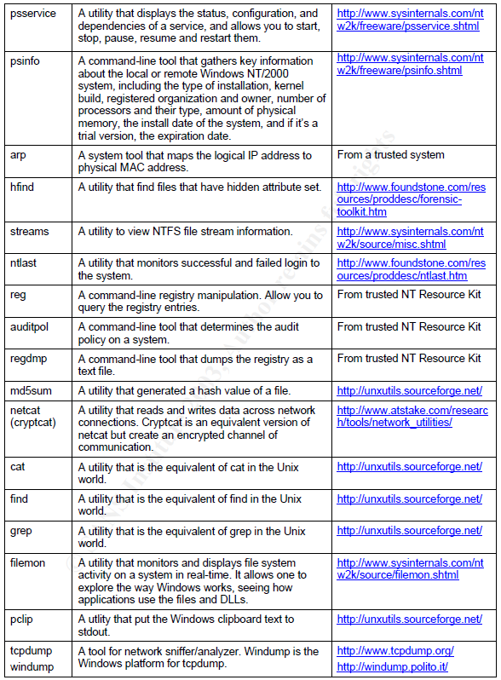
List of Response Toolkit Tools

Slide 30
Gather Evidence
Steps to Proper Evidence Gathering
On External Collection System
Collect System Image
Hash Image
On Target System
Open a Trusted Command Shell
Prepare the Collection System
Collect Volatile Evidence
Collect Pertinent Logs
Perform additional network surveillance

Slide 31
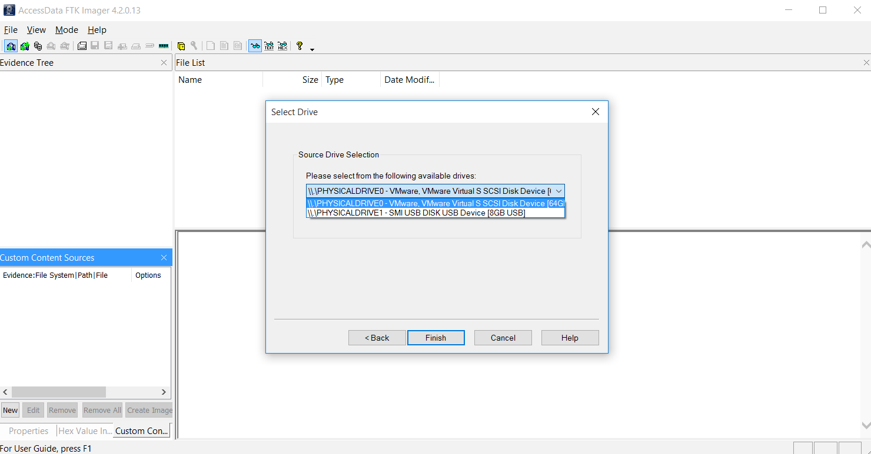
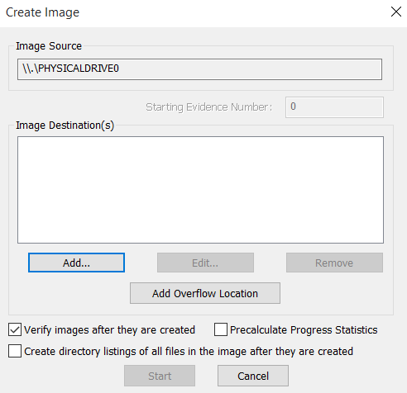
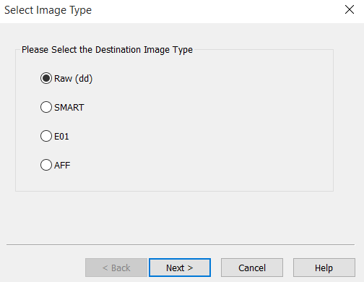
Collect System Image – Removable Media

Slide 32
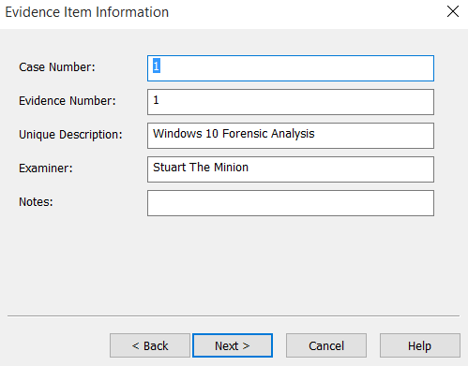
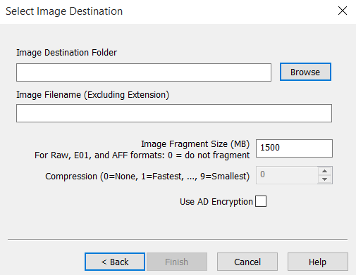
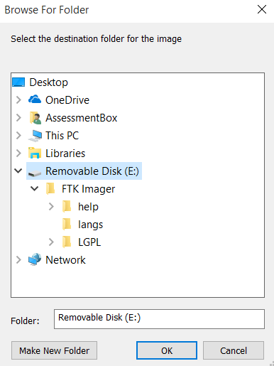
Collect System Image (con’t)

Slide 33
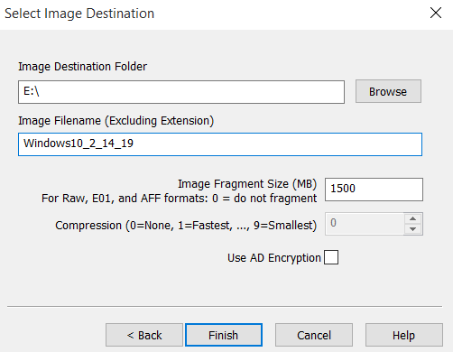
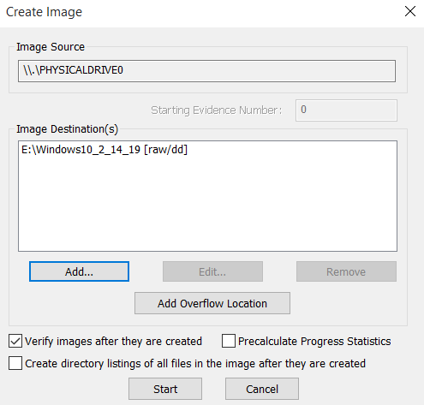
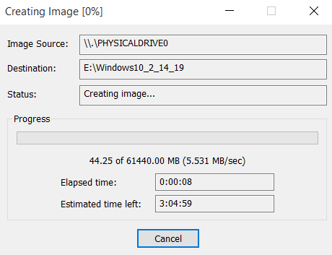
Collect System Image (con’t)

Slide 34
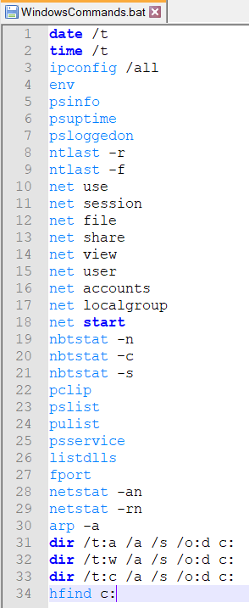
Windows Volatile Artifacts
Volatile evidence includes:
System Information
Running Processes
Open Sockets
Network Connections
Network Shares
Network Users
The batch file can be run from the removable media and the results stored to the media or through an external connection established with a remote tool on the removable media
The key is to minimize interaction with the target system

Slide 35
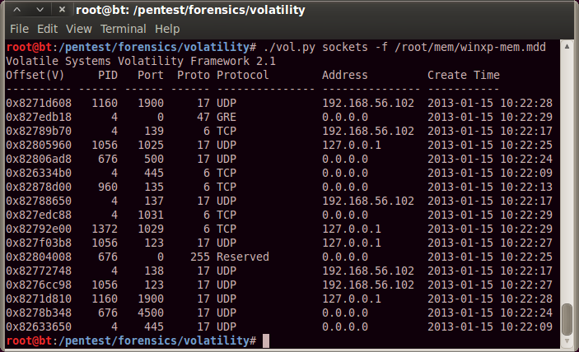
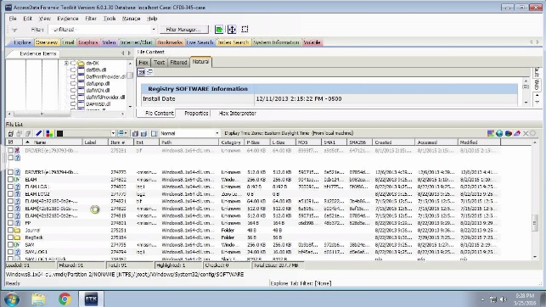


Collect Volatile Evidence – Removable Media
Toolkit
Target System
Analysis System

Slide 36
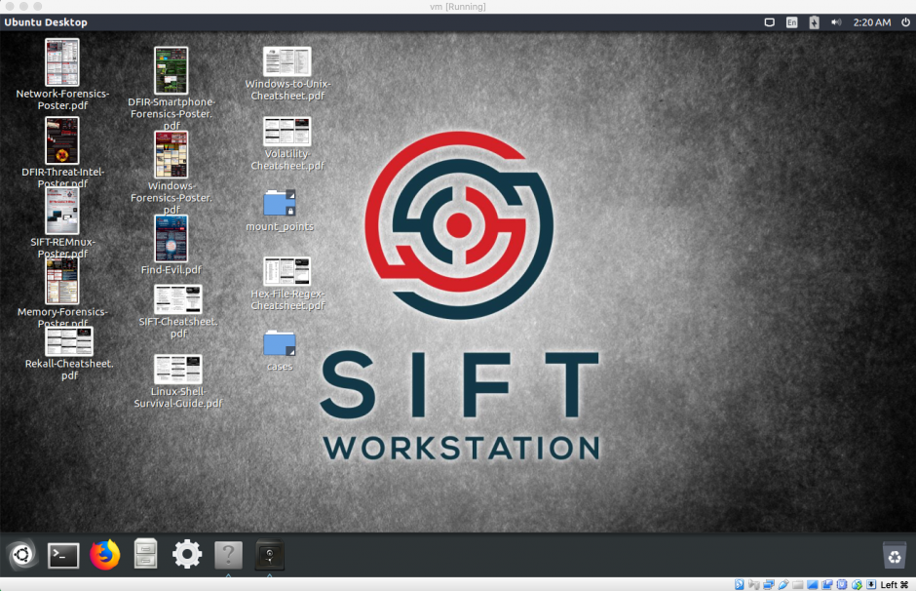
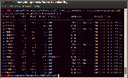
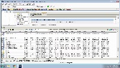
Analyze Volatile Evidence – Removable Media
Toolkit
Target System
Analysis System

Slide 37
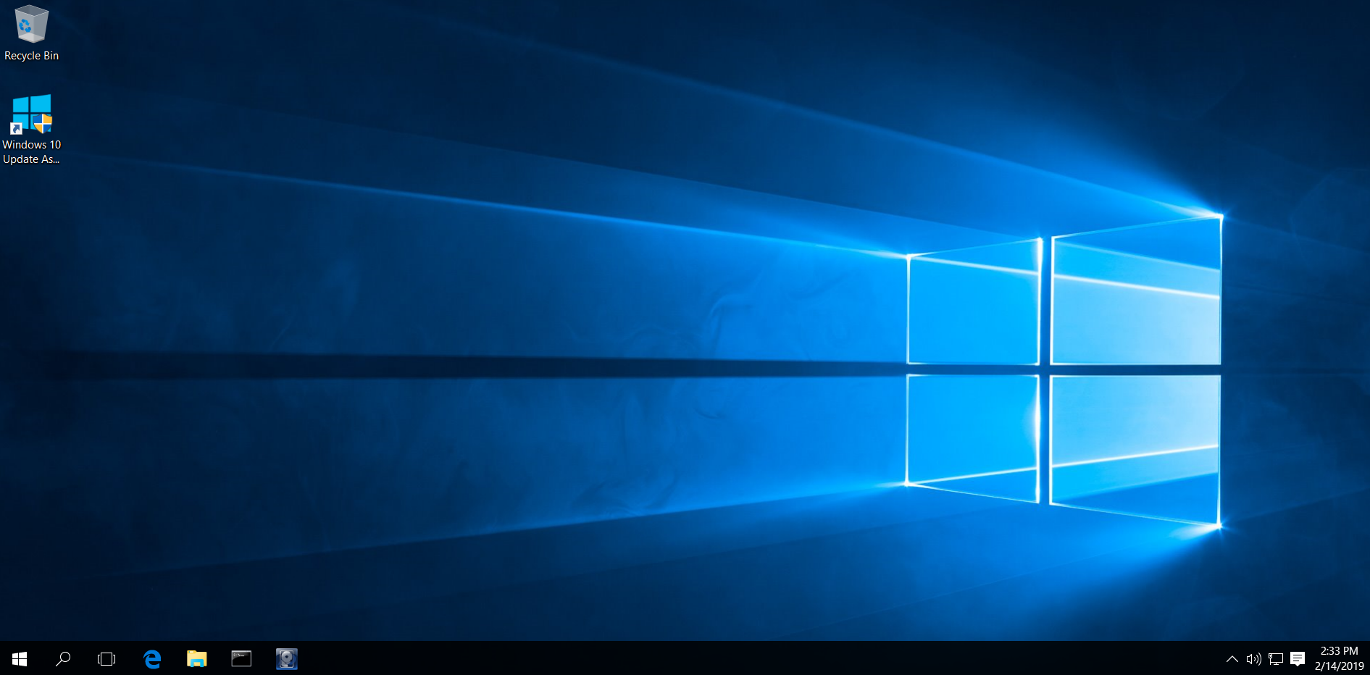
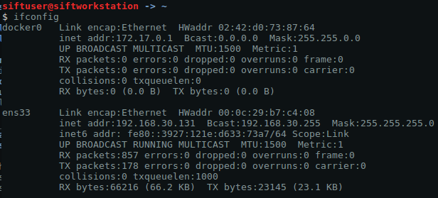
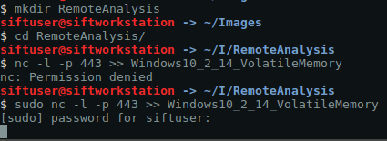
Collect Volatile Evidence – Remote Connection
IP Address
Requires Elevated Privileges
Target System
Analysis System

Slide 38
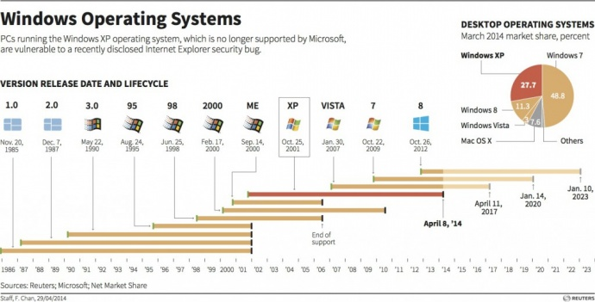

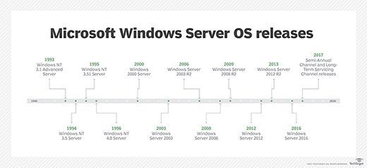
Windows Operating System Version Timeline
10
Jul. 29,
2015
Desktop / Laptop
Server

Slide 39
Windows Operating System Versions
Forensics analysis of Windows is not limited to the most current version of the OS
Organizations maintain copies of both physical and virtualized Windows systems for numerous reasons:
Cost
Labor
Backwards Capability
Applications No Longer in Development
It is not been unusual to see Windows versions as early as:
Windows NT 4.0
Windows 95/98
Windows XP
Windows Server 2003
Forensic analysts should expect to see numerous different Windows OS’s during their analysis
Understanding the different digital artifacts created by each Windows OS is an important skill during analysis

Slide 40
Windows Operating System Modes
Windows is broken into two modes:
User Mode
When executing code in user mode, it can not directly access underlying hardware or reference memory addresses
Access to hardware or memory depends on system Application Programming Interfaces (API)
User mode crashes are recoverable
Kernel Mode
When executing code in kernel mode, it has unrestricted access to the underlying hardware and can directly reference memory addresses
Reserved for the most trusted functions of the operating system
Kernel mode crashes are generally unrecoverable
The CPU is configured to ensure separation of user mode versus kernel mode operation to ensure users do not have access to running processes

Slide 41
Operating System Artifacts
So far our discussion has focused on the underlying file systems of the Windows OS
FAT16 / FAT32
NTFS
When the Windows OS is applied to disk, the file system is augmented with additional artifacts:
Windows Registry
Shell Bags
Event Logs
Recycle Bin
Prefetch Files
Scheduled Tasks
Jump Lists
Application Files

Slide 42
Windows Registry Forensics

Slide 43
Artifacts – Registry Entries
The Windows registry is a “central hierarchal database used to store information that is necessary to configure the system for one or more users, applications, and hardware devices.”
Prior to Windows 2000, specific initialization files were used for system configuration
boot.ini
system.ini
win.ini
Since Windows 2000, a registry structure was utilized to create a more efficient interaction between kernel and user activities
Registry entries contain two different structures:
Registry Key
Similar to a folder in that it hold multiple values
Registry Value
Similar to a file that contains specific values

Slide 44
Windows Registry Operation
A comprehensive copy of the registry can only be found in main memory since it requires both the registry entries along with active processes that create it
From a forensics standpoint, this is significant because gathering a complete registry requires live memory capture
Windows
Boot
Volatile
Registry
Hives
Registry
Hive
Files
Disk
User
Authentication
Registry
Hive
Files
Processes
Main Memory

Slide 45
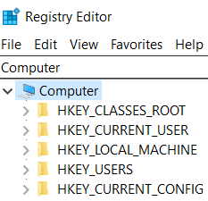
Windows Registry Hives
The highest level object in the Windows Registry is called a root key and the registry contains 5 root keys:
HKEY_CLASSES_ROOT (HKCR)
All information relating to file name extensions and Object Linking and Embedding (OLE)
HKEY_CURRENT_USER (HKCU)
Contains settings for the currently logged on user
HKEY_LOCAL_MACHINE (HKLM)
Contains information about hardware and software of the system
HKEY_USERS (HKU)
Contains information of different user settings and consolidated from HKCU
HKEY_CURRENT_CONFIG (HKCC)
Contains information about current hardware configurations
HKCC is usually empty until loaded during the boot process and loads hardware profiles into sub keys of HKLM

Slide 46
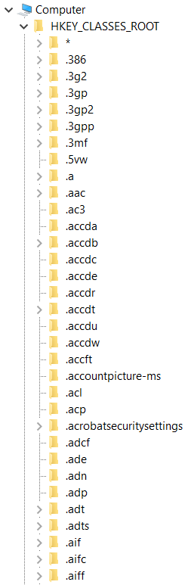
HKEY_CLASSES_ROOT
The majority of the Windows Registry is made up of HKCR entries
HKCR contains a list of all extension associations and describes how files operate with particular applications and are composed of two hives:
HKLM\SOFTWARE\Classes - Machine-based defaults
HKCU\Software\Classes - User-based
The HKCR hive contains data relative to:
User Settings
File Associations
Component Object Model (COM) Objects
Programmatic Identifiers (ProgID)
Example: HKCR\.avi\OpenWithProgIds
Class ID (CLSID)
Example: HKCR\CLSID
Interface ID (IID)
Example: HKCR\Interface

Slide 47
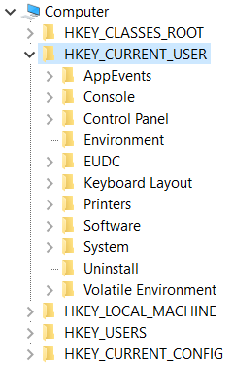
HKEY_CURRENT_USER
HKCU changes each time a user logs into the OS
Each user profile contains user configurations for:
Groups
Network Connections
Desktop Settings
External Peripherals
Each user HKCU data feeds into HKEY_USERS

Slide 48
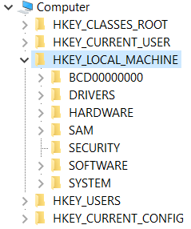
HKEY_LOCAL_MACHINE
HKLM contains hardware, driver, and software configuration data with the following subkeys:
HKLM\Hardware – Visible Subkey
Data relative to CPU, BIOS, and hardware devices
HKLM\Software – Visible Subkey
Alphabetical listing of software vendors
Each program writes data to this registry key when applications start
Also used to find user security identifiers (SID)
HKLM\SAM – Hidden Subkey
Security Accounts Manager is a database of domain information including aliases, usernames, accounts, and password hashes
Only accessible through system account
PSExec
HKLM\Security – Hidden Subkey
Stores current user security policy and is linked to either domain or local security database
Only accessible through system account
PSExec

Slide 49
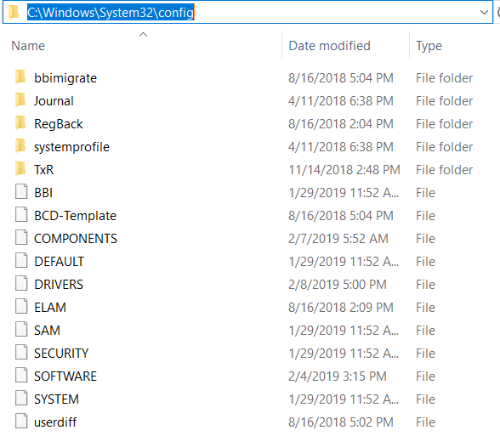
HKEY_LOCAL_MACHINE
HKLM subkeys can be found in:
C:\Windows\System32\config

Slide 50
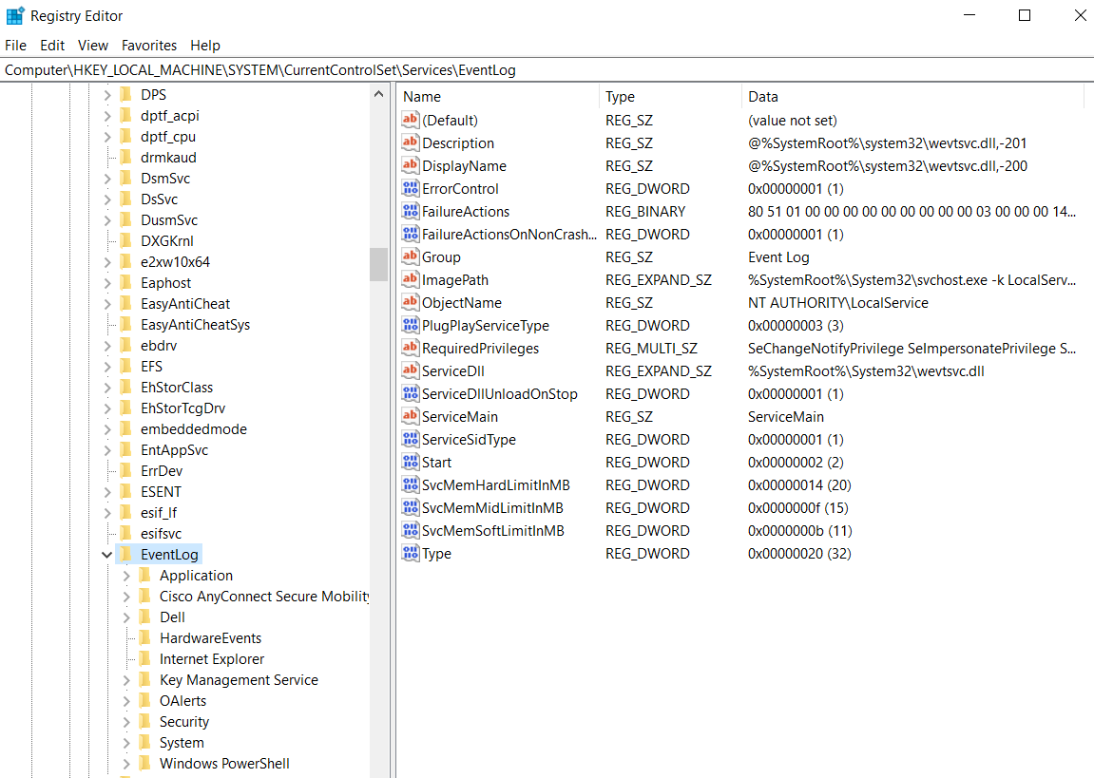
HKEY_LOCAL_MACHINE – Event Logs
HKEY_LOCAL_MACHINE\SYSTEM\CurrentControlSet\Services\EventLog

Slide 51
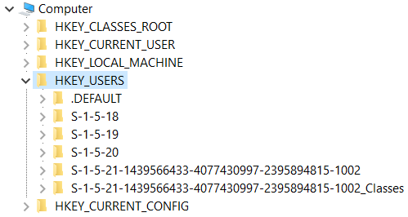
HKEY_USERS
HKEY_USERS registry hive tracks each user with a security ID (SID)
Keys and values under each SID specifies settings such as:
Environment Variables
Mapped Drives
Desktop Configuration
During user login, each of these settings are loaded into main memory
Additional registry keys in HKLM help identify SIDs:
HKLM\SOFTWARE\Microsoft\Windows NT\CurrentVersion\ProfileList
New User Template
System Accounts
Users

Slide 52


HKEY_USERS SID
The Windows Command Line Utility (WMIC) can be used to identify system and user accounts:

Slide 53


HKEY_CURRENT_CONFIG
Unlike the other hives, HKCC does not contain native keys and values
HKCC is a shortcut to the HKLM key that tracks hardware configuration
HKLM\SYSTEM\CurrentControlSet\Hardware Profiles\Current
Changes to either HKCC or the HKLM hardware hive changes the other

Slide 54


Full Windows Registry Export
Before conducting analysis, it is necessary to collect copies of the registry entries
Collection can be of specific registry hives or the entire database
There are numerous collection methods
Direct Registry Export
Live Registry Image
Dead Registry Image

Slide 55

Partial Windows Registry Export

Slide 56


Collect Registry Hives
IP Address
Requires Elevated Privileges
Target System
Analysis System

Slide 57
Windows Registry Query List
The registry query strings can be configured to query each hive or specific keys and values
A tailored list should be developed based on the specifics of each test event

Slide 58
Windows Registry Shellbags
Inside of the registry there are keys that configure the folder dimensions such as size, view, icon, and position
From a forensic standpoint these values are incredibly valuable since these values provide persistent information on when folders and applications were used and allows tracking of previously mounted volumes, deleted files, and user actions
Shellbag registry key:
HEKY\_USERS\{USERID}\Local Settings\Software\Microsoft\Windows\Shell

Slide 59

Windows Registry Analysis Tools
There are a number of helpful Windows Registry collection and analysis tools including:
FTK Registry Viewer
Demo and commercial registry viewer from AccessData
RegRipper
Perl-based Windows Registry data extraction tool
BulkExtractor
High speed disk scanner that analyzes disk images, files, or directories without the need of file system parsing
ShellBags Explorer
Registry shellbag analysis

Slide 60
Additional Windows Artifacts

Slide 61

Windows Artifacts – Event Logs
Windows event logs track changes for numerous applications throughout the OS including:
Application
Security
Setup
System
Forwarded Events
All details relative to how event logs are managed are handled in the Windows registry
Windows log event IDs are used to classify different log levels

Slide 62

Artifacts – Recycle Bin
The collection of artifacts from the recycle bin depend on which version of Windows is being analyzed
Recycle Bin Path
Windows 95, 98, and ME – C:\RECYCLED
Windows NT, 2000, XP – C:\RECYCLER
Windows Vista, 7, 8, 10 – C:\$Recycle.Bin
Metadata File Contents
Windows 95, 98, ME – C:\RECYCLED\INFO2
Windows NT, 2000, XP – C:\RECYCLER\SID*\INFO2
Windows Vista, 7, 8, 10 – C:\$Recycle.Bin\SID*\$Ixx
Deleted File Contents
Windows Vista, 7, 8, 10 – C:\$Recycle.Bin\SID*\$Rxx

Slide 63

Recycle Bin Artifact Recovery
Metadata File Contents
Windows Vista, 7, 8, 10 – C:\$Recycle.Bin\SID*\$Ixx
Deleted File Contents
Windows Vista, 7, 8, 10 – C:\$Recycle.Bin\SID*\$Rxx
Current User
Admin

Slide 64

Recycle Bin User Ownership
Identification of user account and associated security identifier
Demonstration of user account access

Slide 65

Recycle Bin Artifact Recovery
$I represents metadata for the deleted file
$R represents the actual data of the deleted file
Metadata
Metadata
File Data
File Data

Slide 66
Artifacts – Prefetch Files
Prefetch is a term used for caching of important files and libraries
There are two types of prefetch within Windows:
Boot Prefetch
All versions of Windows
Application Prefetch
Windows XP, Vista, 7, 8, 10
Turned off by default on Windows Server versions
Prefetch files can aid in identifying:
When users ran programs
When programs and files were deleted
Identification of malware infection
Building timeline analyses
File download times
Develop methods for root cause analysis

Slide 67

Prefetch Artifacts
Application
Hash
.pf
Path

Slide 68
References
Windows Forensics Analysis Toolkit, Carvey, 2014
Windows Registry Forensics, Carvey, 2009
Windows Forensics Best Practices
http://www.campus64.com/digital_learning/data/windows_forensics/users-guide-to-winfe1.pdf
https://www.sans.org/security-resources/posters/windows-forensic-analysis/170/download
https://www.ncjrs.gov/pdffiles1/nij/199408.pdf
Windows Registry
https://www.techsupportalert.com/content/deeper-windows-registry.htm
https://docs.microsoft.com/en-us/windows/desktop/sysinfo/registry-hives
https://support.microsoft.com/en-us/help/256986/windows-registry-information-for-advanced-users
https://www.sans.org/cyber-security-summit/archives/file/summit-archive-1493923972.pdf
http://www.onlinecmag.com/registry-root-keys
http://www.williballenthin.com/forensics/shellbags
Windows Operating System Modes
https://blog.codinghorror.com/understanding-user-and-kernel-mode

